Slide 1


Alarm Fatigue Demo Overview
Notes:
TALK TRACK
Hello, my name is [NAME] and I want to thank you for taking time to speak with me today.
Hortonworks Powers the Future of Data: data-in-motion, data-at-rest, and Modern Data Applications.
Today, I’ll tell you how we do that and how you can transform your business by managing your data with Hortonworks Connected Data platforms.
[NEXT SLIDE]

Slide 2
Alarm Fatigue Overview
Alarm Fatigue occurs when one is exposed to a large number of alarms and becomes desensitized to them, leading to longer response times or missed alarms
This is prevalent in a high stress environment such as an Emergency room or an ICU
From 2010 to 2015 there were > 130 preventable deaths from alarm fatigue
By reducing the number of alarms sent and only sending the most important ones, desensitization can be prevented and response time improves

Slide 3
Architecture
This Demo uses the following components:
NiFi
Kafka
Schema Registry
Streaming Analytics Manager
Hive
Druid
Superset
Druid
Superset Dashboard
MiniFi / Simulated Data
NiFi
Kafka
SAM
Email Notification
Hive
HDFS

Slide 4
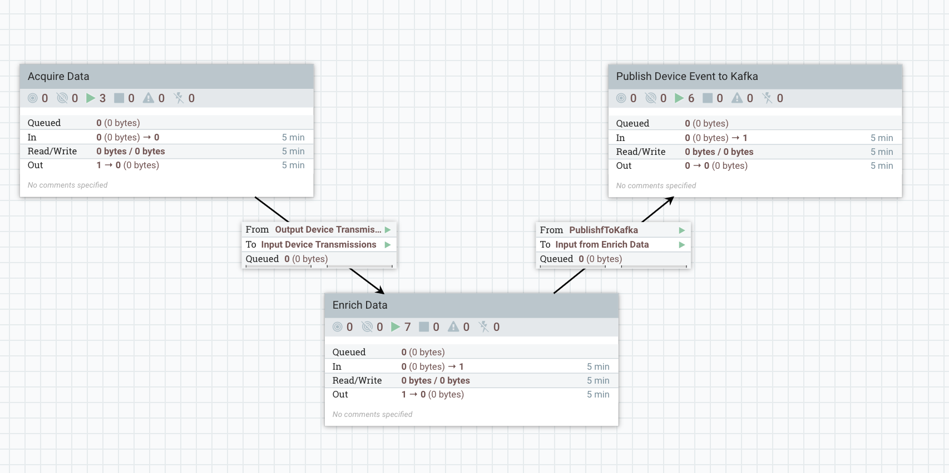

Apache NiFi
NiFi gives users the unique ability to move and transform data.
Very simple drag and drop interface for processors allows a simple user experience
Extensible
Maintains data provenance

Slide 5
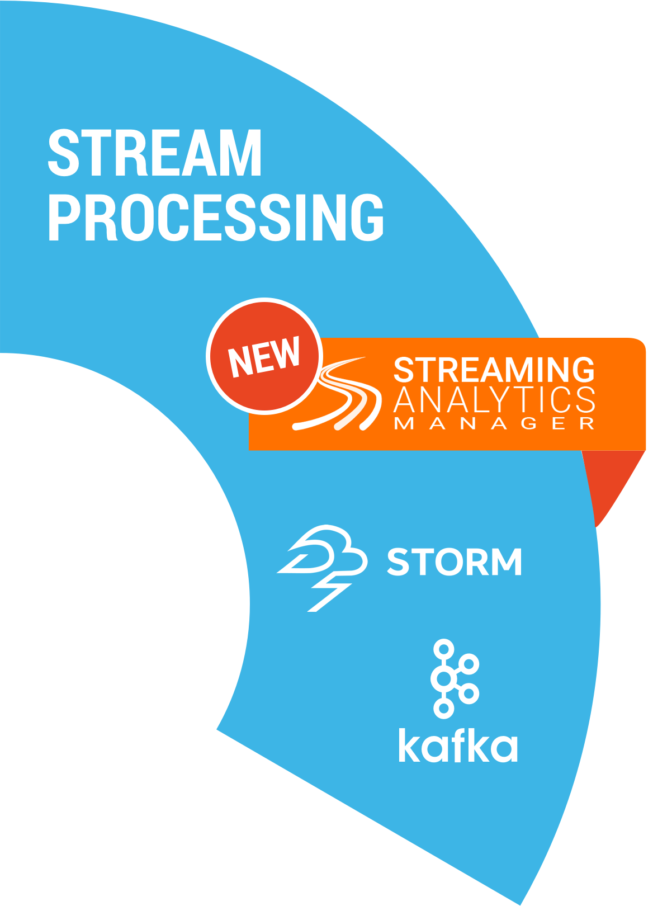
Introducing Hortonworks Streaming Analytics Manager (SAM)
Design, develop, deploy and manage streaming analytics app with a drag-and-drop paradigm
Streaming Analytics Manager

Slide 6
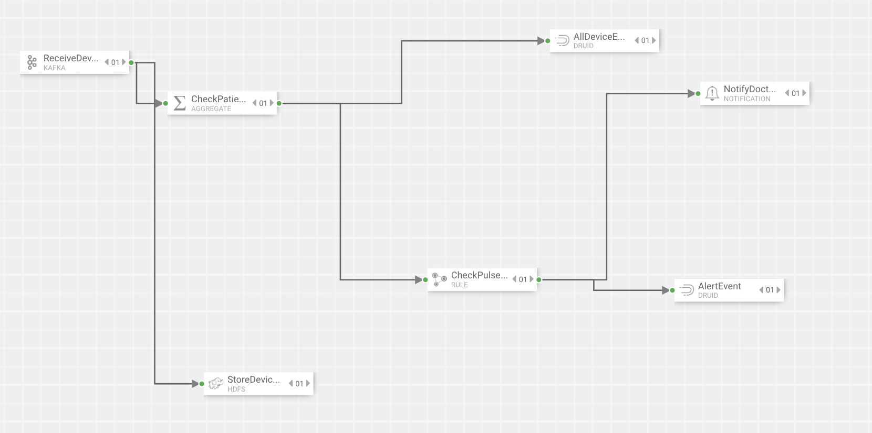
Stream Builder
Builder components, shown on the canvas palette, are the building blocks used by the app developer to build streaming apps.
Drag and drop to build a working streaming application without writing a single line of code.
4 Types of Components: Sources, Processors, Sinks and Custom

Slide 7
SAM is All about Doing Real-Time Analytics on Streams
Real-Time Analytics
Real-Time
Prescriptive Analytics
Real-Time
Predictive Analytics
Real-Time
Descriptive Analytics
What should we do right now?
What could happen now/soon?
What is happening right now?
event correlation
enrichment, routing & filtering
pattern matching
rule-based classification
statistical aggregations with UDAF
Spark mllib model deployment
time series dashboards
visualizations
OLAP queries via Druid

Slide 8
Apache Hive: Fast Facts
Most Queries Per Hour
100,000 Queries Per Hour
(Yahoo Japan)
Analytics Performance
100 Million rows/s Per Node
(with Hive LLAP)
Largest Hive Warehouse
300+ PB Raw Storage
(Facebook)
Largest Cluster
4,500+ Nodes
(Yahoo)

Slide 9

Hive’s Unique Advantages in HDP
Why Hive:
Comprehensive ANSI SQL including 99 TPC-DS Queries.
The only Hadoop SQL with ACID MERGE for easy updates.
Hive on LLAP provides In-Memory caching for MPP performance at Hadoop scale.
Per-User dynamic row and column security.
Replication and DR for critical workloads.
Compatible with every major BI Tool.
Excellent batch query performance thanks to Hive on Tez
Proven at 300+ PB Scale.

Slide 10
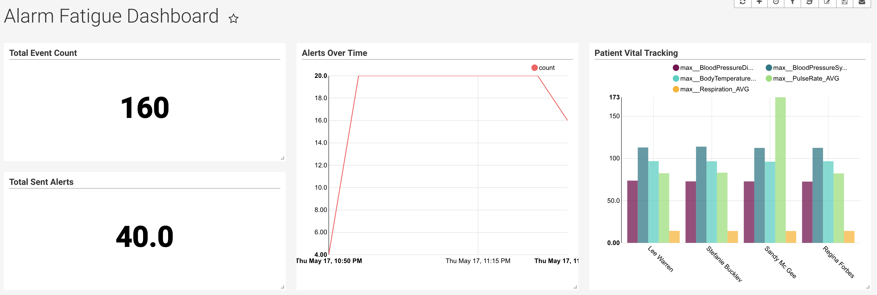
Descriptive Analytics
Create time-series and real-time analytics dashboards, charts, and graphs
30+ visualization charts out of the box with customization capabilities
Powered by Druid and Superset

Slide 11
Demo

